Slide 1

Henry Cutts
s12782638
Mobile Game Development (CMP6187)

Slide 2

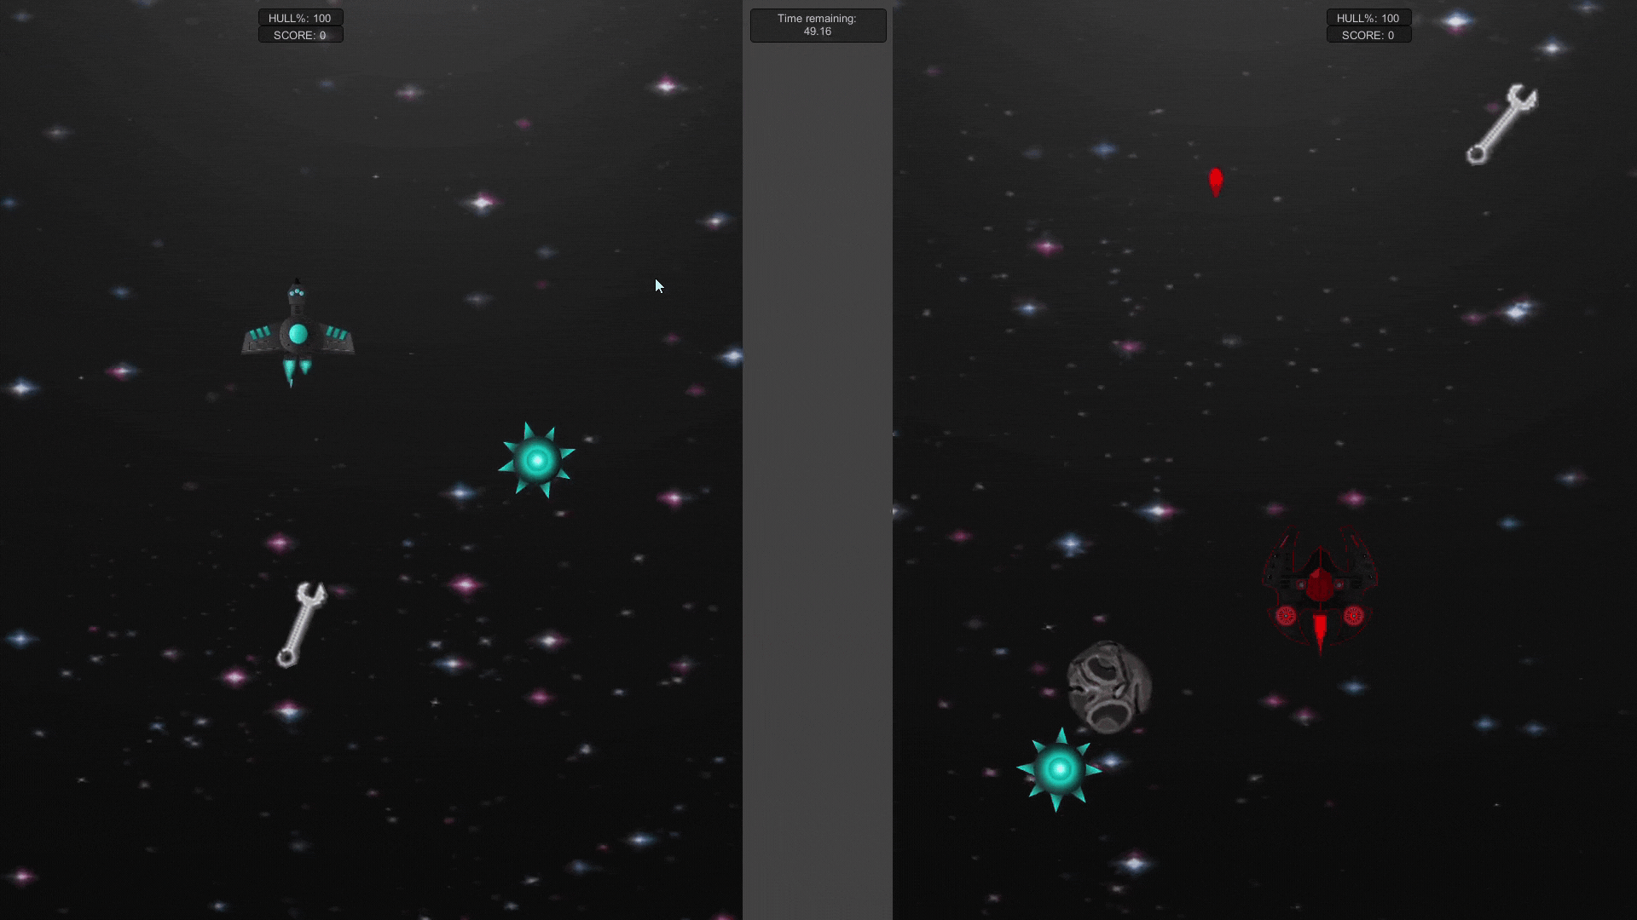
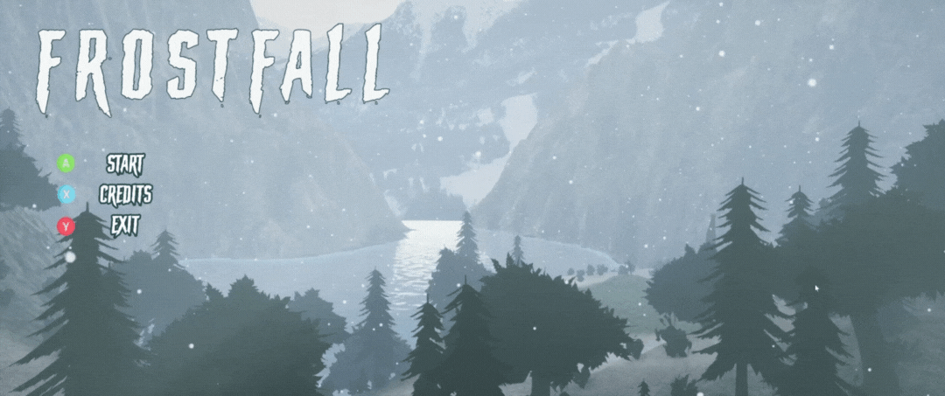
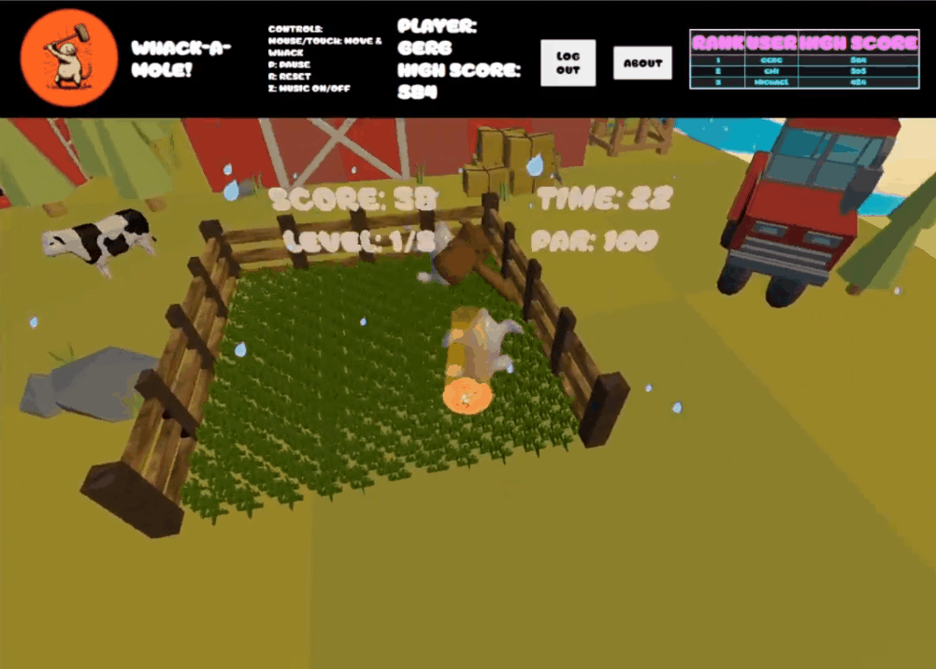
Who am i?
Previous work
I’ve been playing games for as long as I can remember and making them for the past two years.
While most of my gaming experiences have been large, expensive AAA games, I’ve developed a fondness and desire to create smaller indie games.
I believe games have a unique capacity for empathetic communication with players owing to their interactive elements.
MOONSHOT – 2D time-trial racer made in Unity
Frostfall – 3D exploration game made in Unreal
Whack-A-Mole – 3D web-game of mole-whacking goodness made using Three.JS and Node.JS

Slide 3
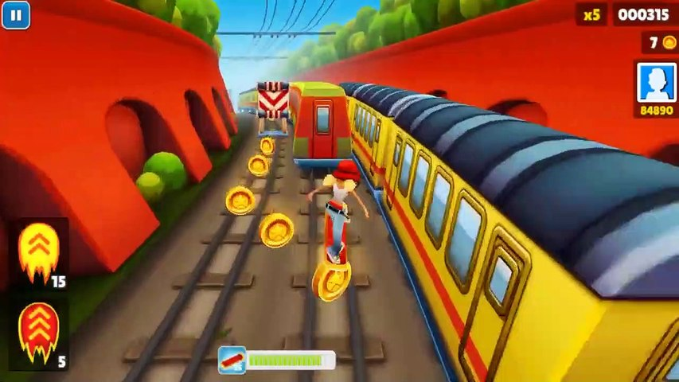
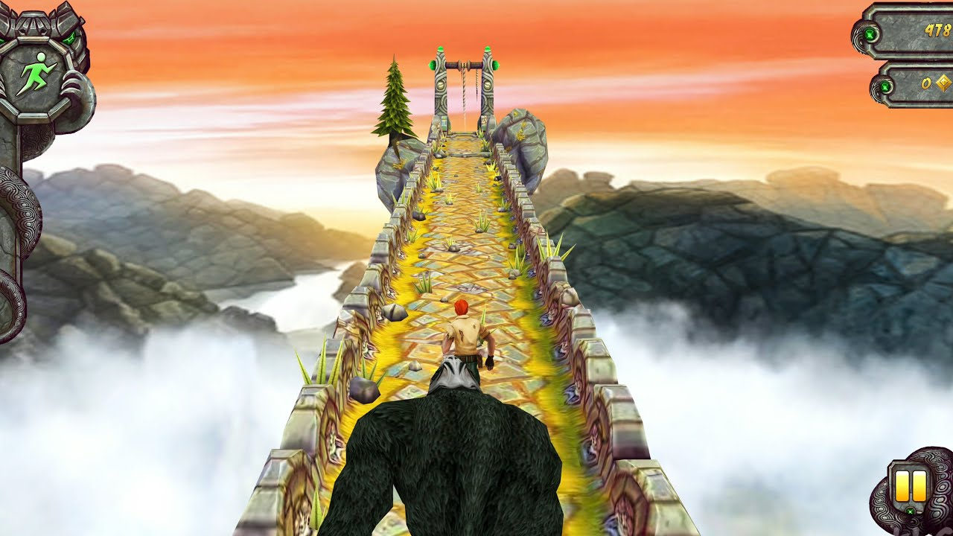
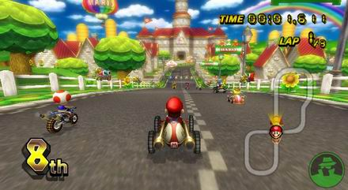
GAME PREMISE
Inspirations
SNOW CRASH is an Endless Runner game where players use simple gyroscopic controls on mobile devices to control a snowboarder heading down a path littered with obstacles, increasing in speed over time.
The player must avoid obstacles while trying to aim for score tokens and gates to delay the level timeout.
Players will compete through direct multiplayer and through high score leaderboards for single-player runs.
Subway Surfers
Temple Run
Mario Kart

Slide 4
PROTOTYPE FEATURES
PLANNED FEATURES
Randomly generated obstacles
Player controlled character
Gyroscope controls
Static 30-second timer limit
High score data persistence*
Gate system
Required gates to pass or suffer penalties
Animated character movement
FX system (snow)
Pre-designed tracks
Curve Segments
Lap system
Multiplayer
Accessibility options
Virtual joystick controls

Slide 5
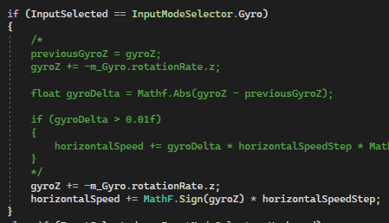
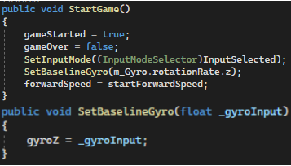
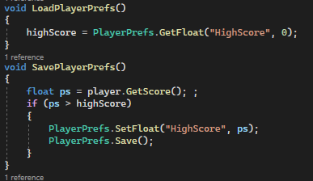
MOBILE TECHNOLOGIES
The game currently uses gyroscope controls with option keyboard controls to use in-editor. The gyro functionality is basic, but is intended to be further developed to be more intuitive and less erratic. Some consideration has been made already for setting a baseline gyroscope input to account for the way the player is holding the device before beginning play.
The Unity Leaderboard API is intended to be used in this game – this allows for score comparison across both Android and iOS platforms with only a single API call.
The game is also planned to include APIs for Ad integration, mobile purchasing for virtual currency (to be used on a cosmetic storefront).
Gyroscope input & baseline code
Data persistence (high scores) code

Slide 6
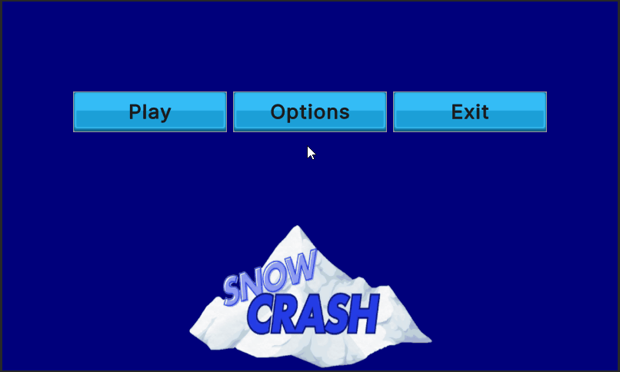
JUICE
Making a good mobile game requires a lot of “juice”, or small visual and audio effects to stimulate player response. A small amount of interactive juice has been implemented in the reactive menu, but there are dozens of planned juice features to be included in the game. Most will revolve around player interaction with the game world and storefront.
PLANNED JUICE
Positive VFX and SFX for score & life gains, timer increases
Negative VFX and SFX for lost lives, low time remaining
Menu transitions
Start game animations and level ease-ins
Store notification pop-ups & highlighted sale items
Menu “proto-juice"

Slide 7
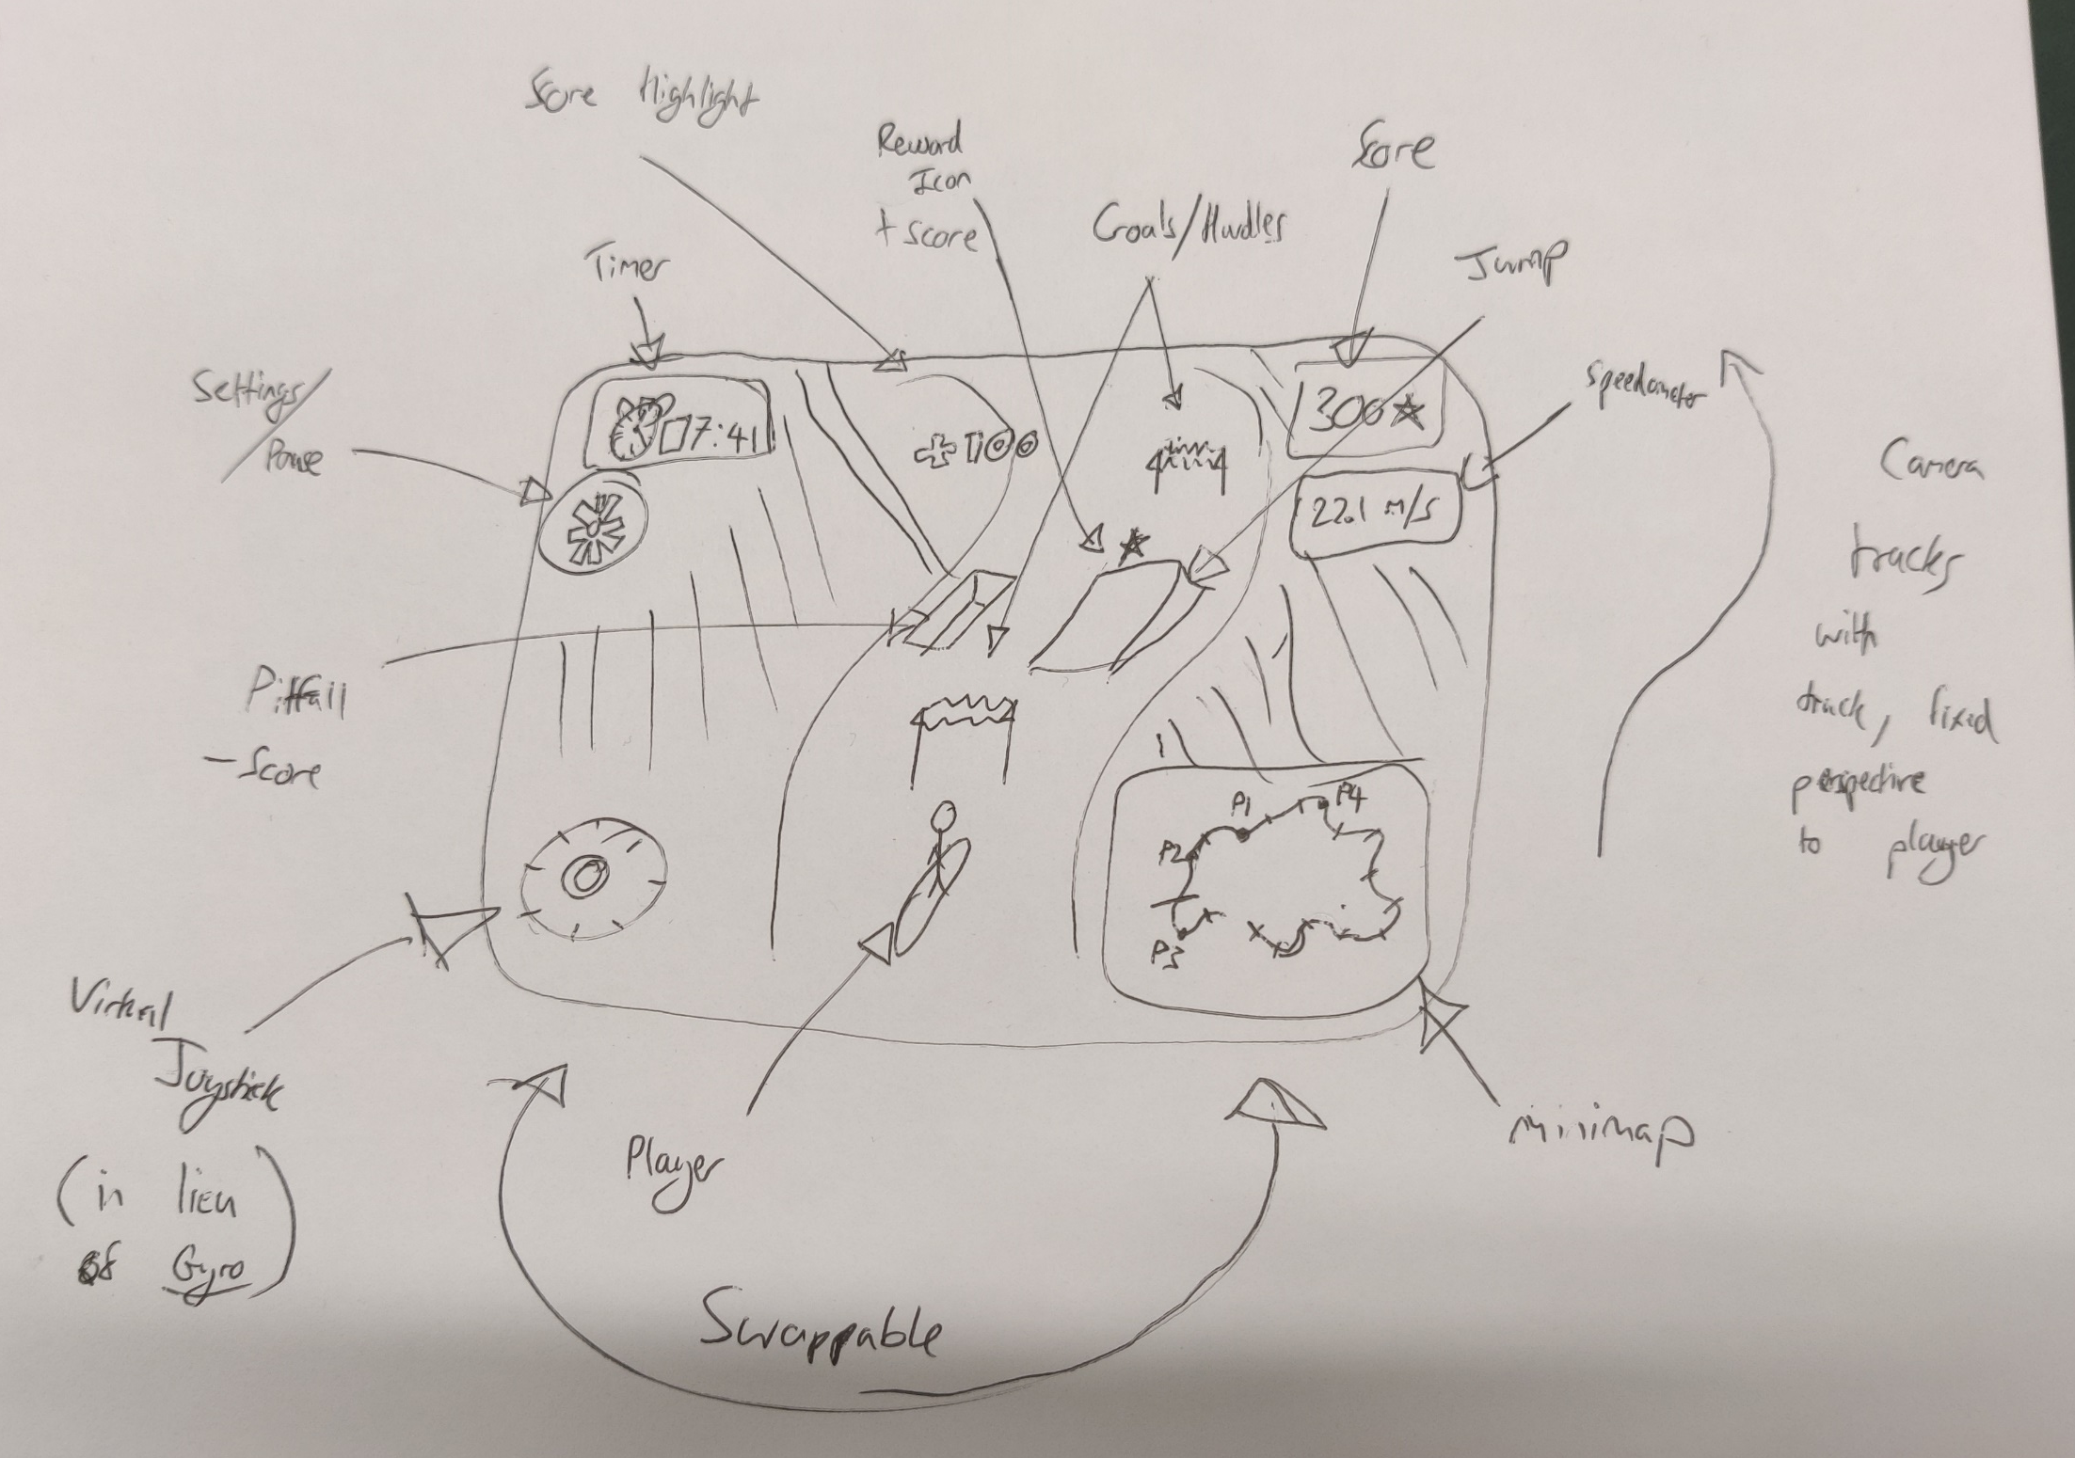
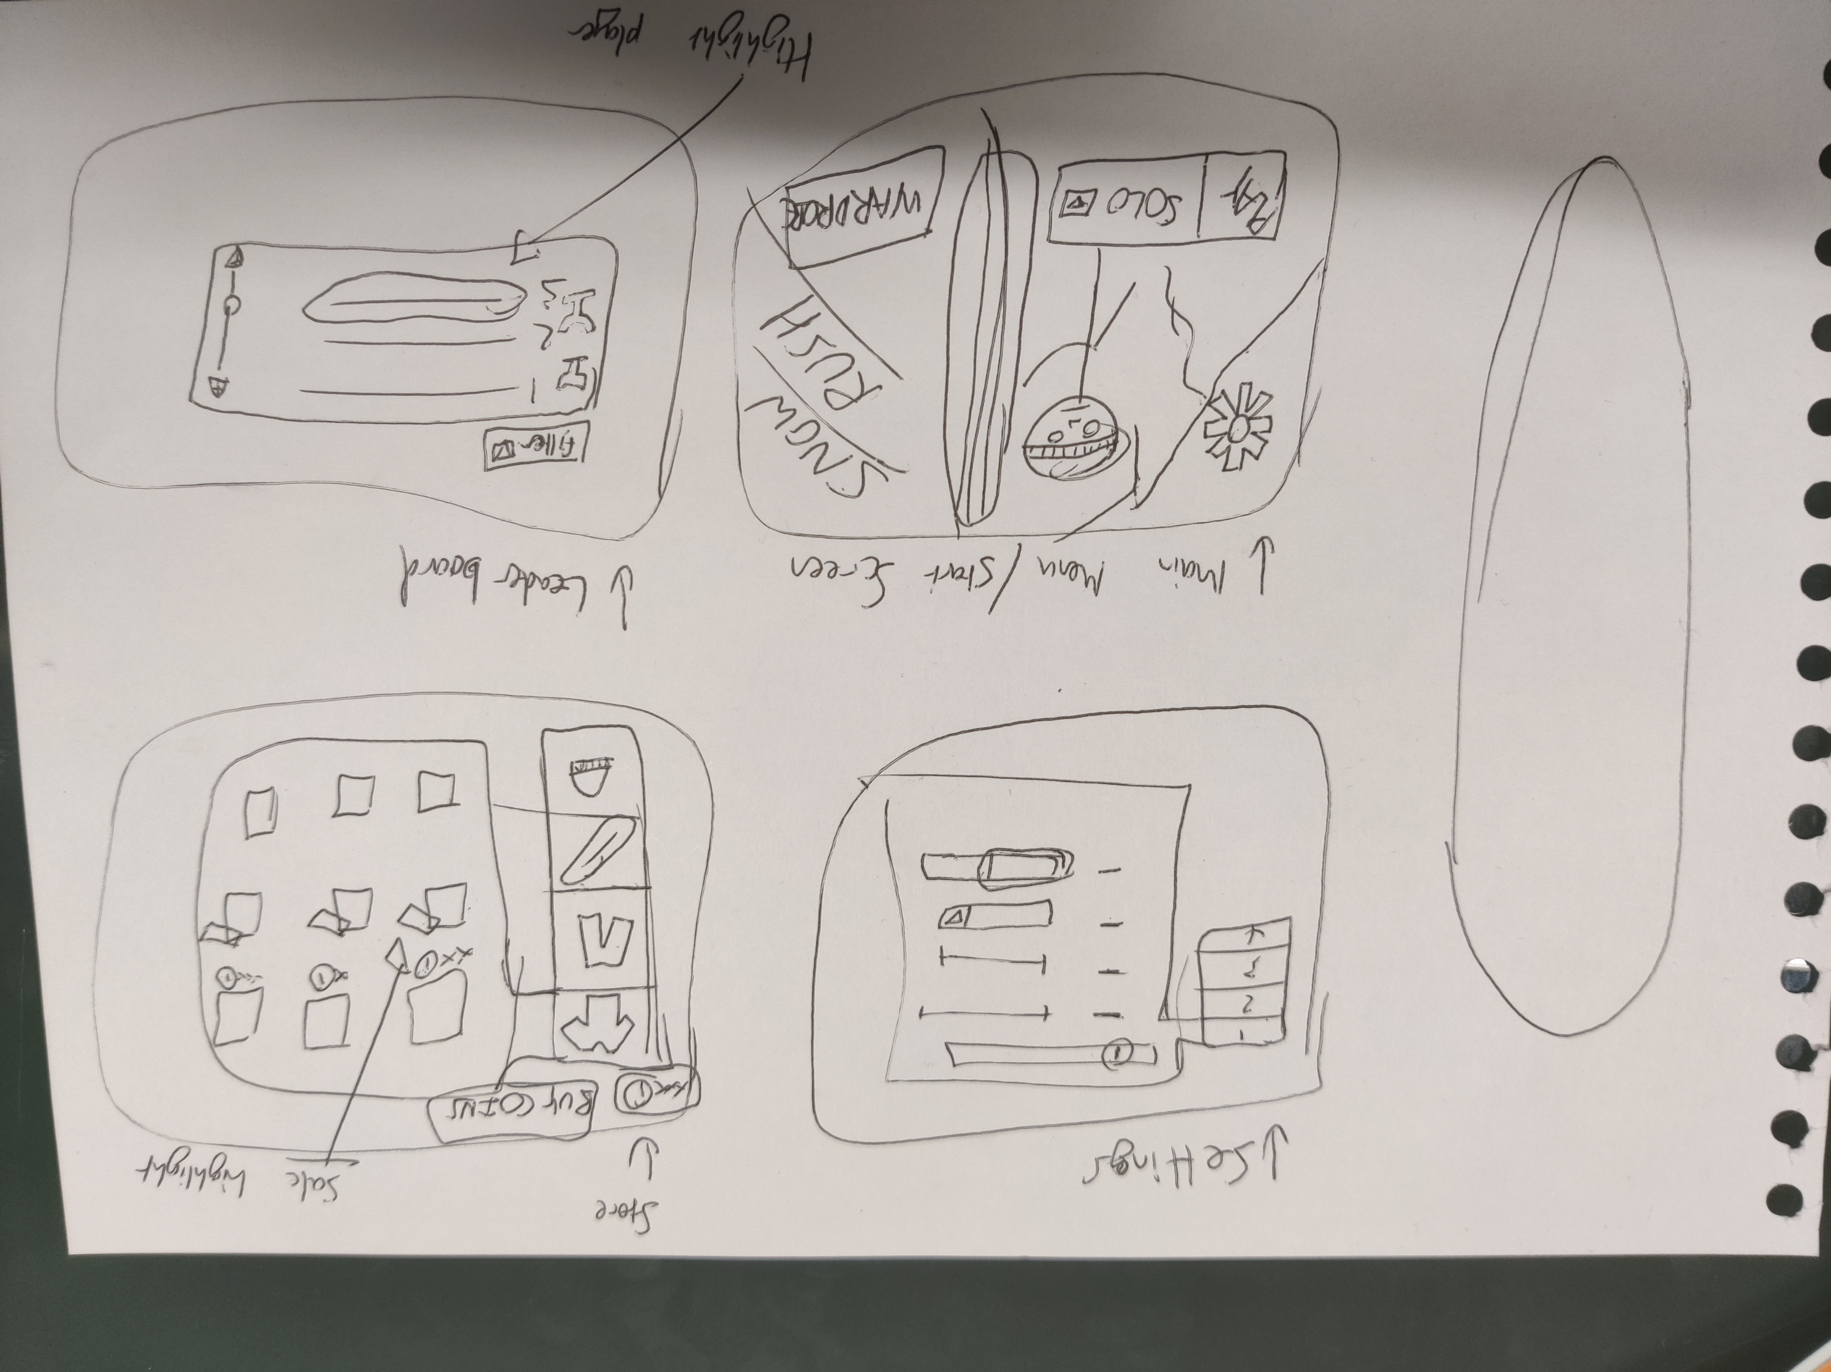
CONCEPT SKETCHES
Concept of in-game screen
Concepts of menu screens

Slide 8
MARKET ANALYSIS
I’ve chosen to create an endless runner game for three reasons:
Hypercasual games occupied 37% of mobile game downloads in 2023^{[1]}, meaning a large market share can be accessed with this format.
The simpler the game, the better^{[2]}. Endless runners offer a simple option for developers to make a game with minimal effort and maximum appeal. This has led to some saturation of the market, however.
Endless runner games are often used as background footage for TikTok and other social media “sludge” videos, generating free advertising so long as the game is sufficiently uniquely branded^{[3]}.
Endless runner games remain extremely popular with the hypercasual audience due to their simplistic playstyle and instant start-stop gameplay. This is particularly appealing to busy working-age people, which corresponds to 74% of the mobile gaming market^{[4]}
Mobile game market shares by type in 2023 ^{[1]}
Demographics of mobile gamers ^{[4]}
[1] https://www.blog.udonis.co/mobile-marketing/mobile-games/mobile-game-market-trends [2] https://supersonic.com/learn/blog/the-past-present-and-future-of-hyper-casual-runner-games [3] https://www.polygon.com/23649389/tiktok-sludge-content-subway-surfers-attention-span-hasanabi
[4] https://www.mmaglobal.com/research/myth-busting-mobile-gaming-demographics

Slide 9
DEMO TIME!

Slide 10
THANKS FOR WATCHING!
Credits
Snowboarder Game Icon by Dreamcreateicons https://www.flaticon.com/free-icons/snowboard - Licence: CC0
"Cheery Monday" Kevin MacLeod (incompetech.com) (CC4.0)
Platform generation code adapted from tutorial by SharpCoderBlog @ https://www.sharpcoderblog.com/blog/endless-runner-tutorial-in-unity-3d
UI Icons pack: By Kenney @ https://kenney.nl/assets/ui-pack (CC0 licence)
Snowy Skybox image: By Sergej Majboroda @ https://polyhaven.com/a/snow_field (CC0 licence)
POLYGON Sampler Pack https://assetstore.unity.com/packages/3d/environments/polygon-sampler-pack-207048
Pitch Background Image: "minimal snowy Christmas winter landscape with falling Snow" by kjpargeter @ https://www.freepik.com/free-vector/minimal-snowy-christmas-winter-landscape-with-falling-snow_366204722.htm

